Slide 1
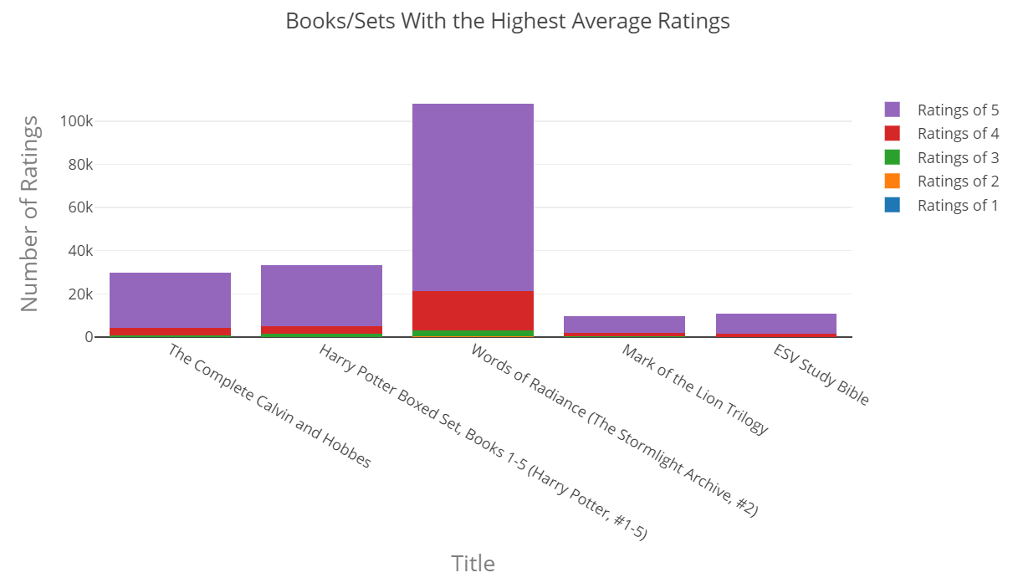
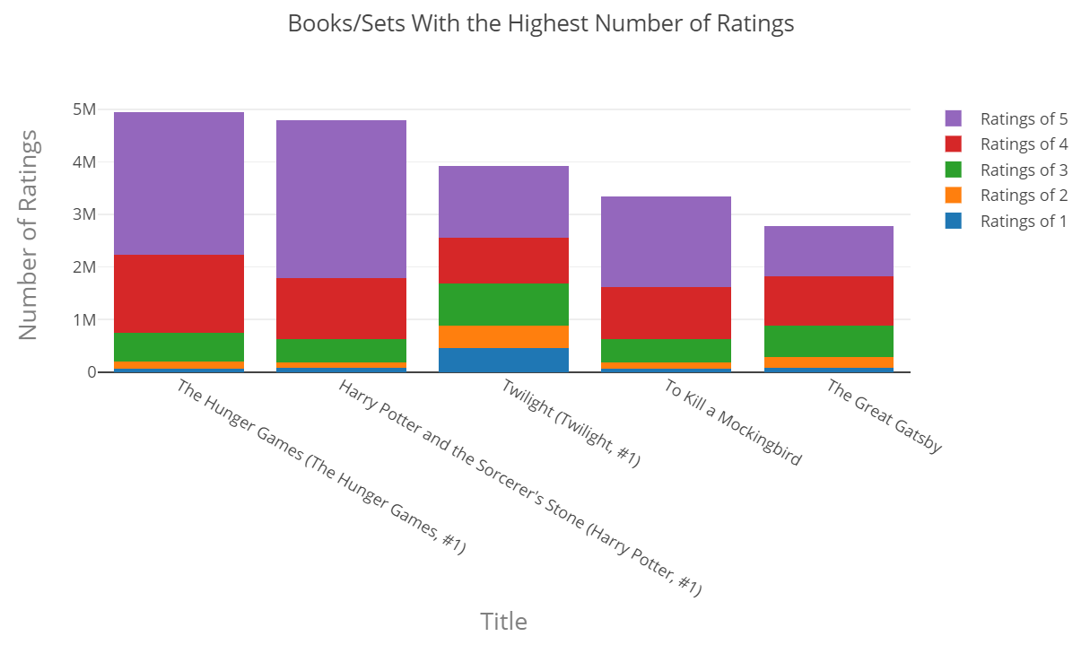
Do the books with the highest count of
ratings (most reviewed) have the highest
average ratings?
That is not the case as the books with the highest average
ratings and the ones with the highest number of ratings
do not match.
The ones with the highest average ratings have way fewer
reviews and the proportion of ratings of 5 are higher.

Slide 2
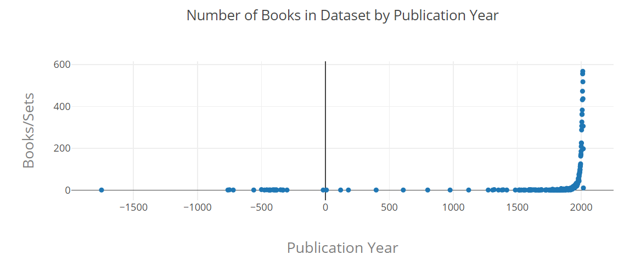
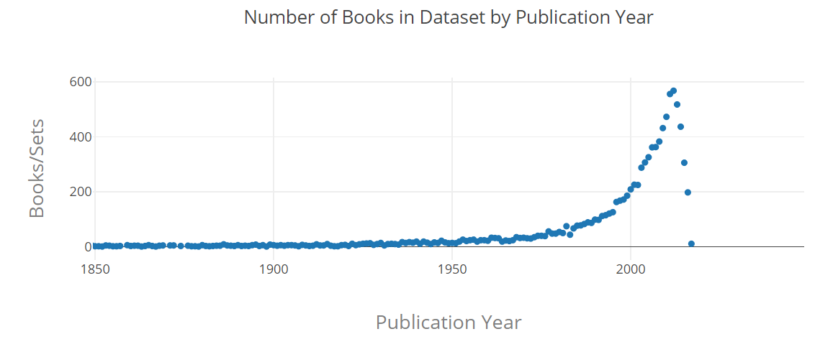
Are books more recently published
more popular? (As this dataset only
Includes 10,000 of the most popular
books on Goodreads.com)
As the publication year increases,
So does the number of books found
In this dataset. We should keep in mind that more books are being published now than ever before.

